Slide 1
Donna Albert, DES Energy DES Trade Show Nov 4 – 5, 2015
No-Cost/Low-Cost
Energy Savings
Notes:
Hi, I’m Donna Albert, one of the energy engineers in the DES Energy Program. I spend most of my time managing building energy retrofits for cities, school districts, agencies, colleges and universities, but today I want to talk to you about no-cost or low-cost ways you can save energy in your buildings.

Slide 2
Building Energy Benchmarking
Measure what you want to manage
Energy
Notes:
The first step to finding and maintaining energy savings is to know how much energy your buildings are using. State agencies, colleges and universities are benchmarking building energy use in the Environmental Protection Agency’s Portfolio Manager. Building energy benchmarking is recording a building’s energy use over the course of a year. This establishes a baseline that can be used to compare the building to itself over time, or to compare it to similar buildings.

Slide 3
Benefits of Benchmarking
Identifying Opportunities
Notes:
You can use Portfolio Manager to identify lowest performing campuses or buildings, by comparing similar facilities across your portfolio.
In July 2011, for those agencies and colleges which had entered data, DES has used that data to recommend energy audits for facilities using more energy per square foot than the average. See the DES Evaluation of Non-Rated Building Types on the DES Energy Portfolio Manager website.

Slide 4
Building Energy Benchmarking
Measuring the energy used by a building:
Compared to itself, by tracking improvement over time
Compared to other similar buildings
Notes:
Building Energy Benchmarking is measuring the energy used by a building compared to itself over time, or compared to other similar buildings.

Slide 5
Tracking Progress
Greenhouse Gas Goals
Energy Reduction Goals
By building, by campus, by agency
Notes:
You can use Portfolio Manager to track your progress toward GHG and Energy reduction goals.

Slide 6
For State Agencies, Colleges and Universities in Washington
Benchmarking Requirements
RCW 19.27A.190 Energy Benchmarking Law
Buildings over 10,000 gsf must be benchmarked in Portfolio Manager
Energy audits and retrofits of poor performing buildings
No leasing poor performing buildings
Notes:
Here’s a review of the Energy Benchmarking Law, which requires agencies and colleges benchmark buildings and campuses over 10,000 sf in Portfolio Manager, and share with DES.
There are four steps required by the Energy Benchmarking Law:
1.Benchmarking building energy use
2.Preliminary energy audits
3.Investment grade audits
4.Building energy retrofits
You should be on Step 4: Building Energy Retrofits
Retrofits are to be completed by July 1, 2016. Go to the DES Energy Portfolio Manager website to view your agency in the DES Evaluation of Non-Rated Building Types. Call me if you have questions.

Slide 7
Agencies, Colleges and Universities Applying the Benchmarking Law
Request comprehensive preliminary audits
Based on recommendations from the preliminary audit, do investment grade energy audits
Pursue all cost effective energy conservation measures
Notes:
For Agencies, Colleges and Universities required to do audits by the July 2011 DES Evaluation of Non-Rated Building Types, you should be taking these steps: Read slide

Slide 8
Cost Effective Energy Conservation Measures
Ensure all systems and buildings on a campus are included in the audits
Pursue measures that reduce energy use most cost-effectively, consider long-lasting benefits
At the least, pursue all measures that can be included in an energy conservation project which pays for itself within 10 years using utility incentives and utility bill savings
Notes:
Read slide

Slide 9
EO 12-06 Compliance Update
Commerce, WSU Energy, DES and Smart Buildings Center helped Executive Agencies get benchmarking up to date
Executive Agencies are now almost 100% benchmarked at the campus or stand-alone building level
Energy data is current, and shared with DES
Notes:
Here’s an update on the Executive Agencies’ progress in benchmarking, in response to EO 12-06. Read slide. Next we need to focus on getting non-exec agencies, colleges and universities up to date in Portfolio Manager.

Slide 10
Energy Performance Gap
Normalized EUI for existing office buildings varies widely
30 kbtu/ft2 to 340 kBtu/ft2
Age and equipment not significant drivers of EUI
Number of Buildings
100
75
50
25
1
29.9
86.0
121.1
165.7
339.4
EPA Rating &
Energy Intensity
(kBtu/ft²-year)
Best Performers
Worst Performers
Notes:
The Energy Performance Gap: This is a typical office building energy use distribution from EPA. The graph for other building types is similar. One startling thing about this distribution is the wide variation of energy use per sq. ft. Buildings in the worst performing 25% use more than TWICE as much energy on average as buildings in the best performing 25%.
Age of the building and the presence of efficient technologies are not significant predictors of energy use. As many new buildings and good technologies are among the top as they are in the bottom.

Slide 11
$

Slide 12
Energy Performance Gap
Normalized EUI for existing office buildings varies widely
30 kbtu/ft2 to 340 kBtu/ft2
Age and equipment not significant drivers of EUI
Number of Buildings
100
75
50
25
1
29.9
86.0
121.1
165.7
339.4
EPA Rating &
Energy Intensity
(kBtu/ft²-year)
Best Performers
Worst Performers
Notes:
This graph shows there is a tremendous amount of money spent on wasted energy and poor maintenance. Here in Washington we are better than the national average, but there are still great opportunities. Reduce energy waste, and use the savings to invest in building operation and maintenance. Our buildings are not ATMs. Don’t let agency management spend “easy” energy savings from replacing lighting on an unrelated program elsewhere. Invest your savings in deeper energy retrofits. Invest in training for your maintenance crew. Invest in a Resource Conservation Manager. Tell management in the long run properly maintaining and operating your buildings will cost less than neglecting them.

Slide 13
Interpreting Results
Best investment opportunities are in lower quartiles - greatest potential for improvement
RCx & O&M improvements yield savings and label candidates
High scoring sites provide lessons learned and label candidates
Reward & Learn
Invest & Tune
Tune
Invest
1
25
50
75
100
Percentile
13
Notes:
Here’s another way to look at that graphic : See the percentile scores along the bottom? Where do you want to put your money? That’s right, identify and invest in the worst performers. Where will you find your success stories, to learn from and share strategies with others? The top 25%.
Successful benchmarking can help to:
Plan and prioritize retrofits
Make energy costs visible
Identify best building management practices across a portfolio of buildings
Inform management and capital investment decisions
AND Communicate good results to the public

Slide 14
Building an effective program
ENERGY STAR’s
Guidelines for Energy Management
A framework for how to develop an energy program
Based on best practices from successful ENERGY STAR partner companies.
Structured on a “plan-do-act-check” approach. Informed the ISO 50001 standard.
The foundation for the energy programs of thousands of organizations in the U.S.
ENERGY STAR Guidelines for Energy Management
14
Notes:
The next step is to go beyond basic building energy benchmarking to build an effective energy management program. See the EPA’s Guidelines for Energy Management, on the Energy Star website to build your energy management program.
Energy is precious, and the use of it comes with great responsibility. We can pursue aggressive energy savings strategies, and create a culture of sustainability throughout all our agencies, top to bottom.

Slide 15
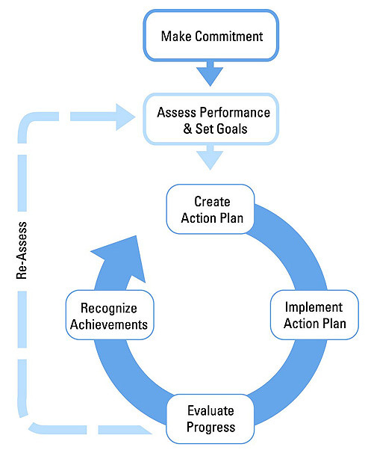
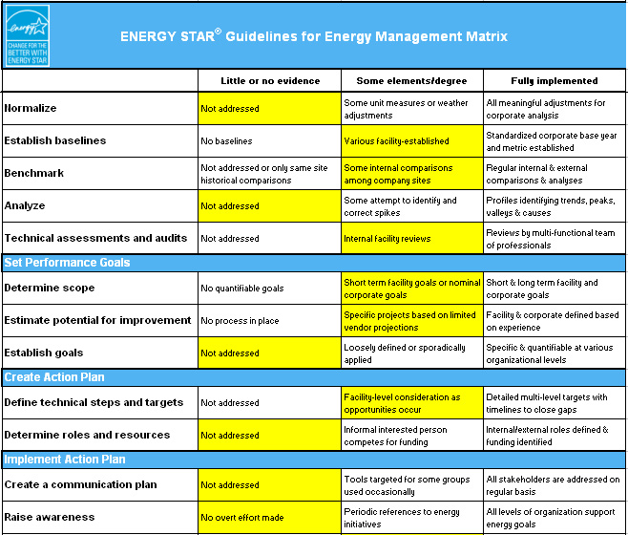
Assess your energy practices
Use the Energy Program & Facility Assessment Matrices
(Appendix 1 of the EPA Guidelines for Energy Management)
15
Notes:
Evaluate your energy program practices & identify gaps using the assessment matrices the appendix of the EPA Guidelines for Energy Management.
https://www.energystar.gov/sites/default/files/buildings/tools/Guidelines%20for%20Energy%20Management%206_2013.pdf

Slide 16
Engage employees
Use posters to raise awareness of plant energy spend, goals, etc.
Show people how they can make a difference.
Help people make the connection to saving energy and money at home.
Use free ENERGY STAR resources.
GET PEOPLE INTERESTED!
16
Notes:
Engage building occupants. You never know where the next good idea will come from. You need support at all levels of your organization to get good results.
The people who do the work in your building make decisions that affect energy use every day. They play a critical role in how energy is used. After all, plug loads typically account for 30 percent of a building’s energy use, and even more in very efficient buildings. The actions of building occupants impact how your systems run, especially if they do things like covering vents, disabling light fixtures, changing thermostat settings, and bringing in space heaters … signs that perhaps your building systems aren’t functioning as intended!
By working with building occupants, you can empower and engage them to become part of the solution. ENERGY STAR partners have demonstrated that it’s possible to save 10 percent or more through occupant education and behavioral change.

Slide 17
We’re competing!
17
Notes:
We are competing in the EPA’s Battle of the Buildings, a national building competition.

Slide 18
About the 2015 Competition
For the second consecutive year, EPA’s ENERGY STAR program is hosting the Battle of the Buildings: Team Challenge
Buildings and teams compete to see who can reduce their energy waste the most.
*Available for Federal and non-Federal buildings and teams
Available EPA Recognition for energy and water savings | Criteria
Overall Top Team* | Percentage-based reduction in energy or water use from 2014 to 2015
Overall Top Building*
Top Building by Category
20% Team Reduction* | 20% or more reduction in energy or water use from 2014 to 2015
20% Building Reduction*
18

Slide 19
About Our 2015 Team
We have buildings in this competition!
Buildings from DES, DVA, ECY and Pierce College are participating in the 2015 Battle of the Buildings. DVA is in the lead with Pierce College next. The group reduced energy use by 8% in the first 6 months.
Our numbers:
Starting weight: 256 million kBtu’s (Source Energy)
If we reduce energy use by 10%, we’ll save:
25.6 million kBtus, enough to power a 150,000 sf office building!
The winner of the 2015 Battle of the Buildings will be announced in April 2016.

Slide 20
About the 2016 Competition
Registration period is expected to open from January 1, 2016 to May 31, 2016
Buildings and teams compete to reduce 2016 energy compared to a 2015 baseline
Building and team progress tracked at www.energystar.gov/BattleoftheBuildings
EPA is expected to announce public launch of competition in July, 2016
Winner will be announced in April 2017
20
Notes:
About the 2015 Competition – DEPENDING ON FUNDING, (read slides)

Slide 21
About Our 2016 Team
We are competing as part of a team!
All the state agency, college and university properties in Portfolio Manager will participate
Get ready!
Are all your properties in Portfolio Manager?
Are they shared with DES?
Is energy data current in Portfolio Manager?
Notes:
DES, Commerce, WSU Energy and the Smart Buildings Center have been working together to help Executive Agencies get their energy data current in Portfolio Manager, to comply with Executive Order 12-06. The Executive Agencies have really stepped up, and all of them are now up to date in Portfolio Manager. I will be calling each of the non-Exec agencies, colleges and universities to let you know what I see in Portfolio Manager for your agency or college. I am here to answer questions and provide technical assistance. WSU Energy is available to get you up to date for a fee.

Slide 22
Learn more at
www.energystar.gov
22
Notes:
More resources available to you at energystar.gov.

Slide 23
DES Energy Website
http://www.des.wa.gov/services/facilities/Energy/EnergyStar
Notes:
Here is the DES Energy Portfolio Manager website.

Slide 24
Thank you
Donna K. Albert, DES Energy Project Manager
Phone: (360) 489-2420
E-mail: donna.albert@des.wa.gov
Website: http://www.des.wa.gov/energy
Portfolio Manager website: http://www.ga.wa.gov/energy/EnergyStar.htm
Another Resource:
Larry Covey, WSU Extension Energy
Phone: (360) 956-2056
E-mail: coveyl@energy.wsu.edu

