Slide 1
South Campus Replacement & Addition Project
Application to use Progressive Design-Build
Project Review Committee Meeting September 23, 2021

Slide 2
Agenda
Introductions
Project Description
Why Progressive Design-Build?
Schedule
Budget
Subcontractor Outreach
Q&A

Slide 3
Introductions – Our Team
Jefferson Healthcare
Jacob Davidson
Chief Ancillary and Support Services Officer
Aaron Vallat, Assoc. DBIA
Construction & Planning Manager
OAC Services
Brent Wilcox, Assoc. DBIA
Program Manager
Melissa Teichman, Assoc. DBIA
PDB & Healthcare Advisor
Dan Chandler
PDB Advisor

Slide 4
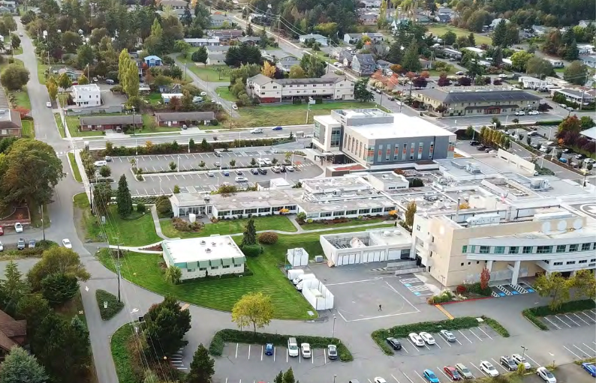
Introductions
Jefferson Healthcare, a rural critical access hospital located in Jefferson County
Our neighborhood
Single family homes, apartments
Assisted living facilities
Dove House
Historic hotel
We provide a broad spectrum of inpatient and outpatient services

Slide 5
Introductions – Mission, Vision & Values
MISSION
To hold the trust and improve the health of the community through compassionate care, innovation and medical excellence.
VISION
Jefferson Healthcare will be the community’s 1st choice for quality
health care by providing exceptional patient care to every person we serve.
VALUES
Compassion Integrity Excellence
Stewardship Respect Teamwork

Slide 6
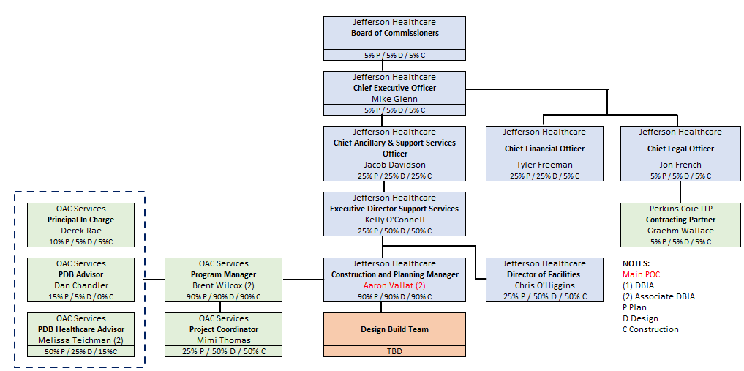
Organizational Chart

Slide 7
Jefferson HC Project Delivery Experience & Qualifications
JH team has over 3 decades of public works expertise.
JH is fully invested in Alternative Delivery and creating a collaborative project culture to improve delivery and better serve our community.
Aaron Vallat recently completed DBIA training and passed his Assoc. DBIA exam.
Internal processes and control systems to efficiently plan and execute the work.
A strong team and partnership with OAC and Perkins Coie.

Slide 8
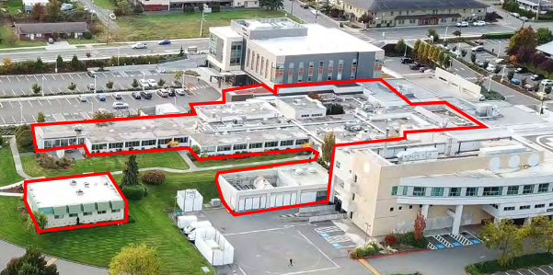
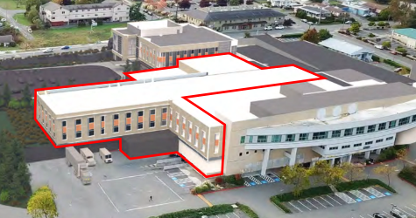
Project Description
Current – Area of impact highlighted
New

Slide 9
Project Scope
Replacement of existing 1965 building – 36,500 SF
New MOB/ASC attached to replacement – 54,000 SF
Basement addition – 10,000 SF
Total of 105,000 SF of new construction
New linear accelerator, express clinic, cardiac rehab, MRI suite, dietary department, Facilities space, EVS, etc.
Relocation of Primary Care, Women’s Health, Dermatology, Urology & Sub-Specialties.
New services: ENT, Pulmonology, Neurology

Slide 10
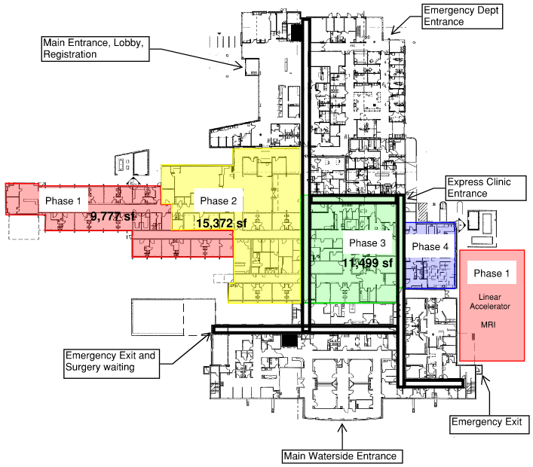
Project Scope: Potential Phasing Plan

Slide 11
Why PDB?
Activities are Specialized
Ongoing hospital operations and access.
Special training and collaboration with hospital staff.
Opportunity for Greater Innovation and Efficiencies
Complex phasing, early investigating, early procurement, delivery sequencing.
Savings in Project Delivery Time
Streamlining and integration of project team.
Efficient sequencing of entire project delivery.
Confirm budget early in design = Predictable outcomes.

Slide 12
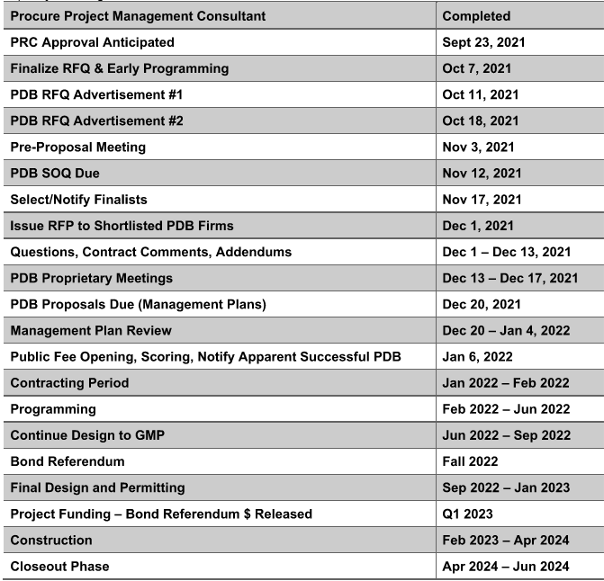
Schedule

Slide 13
Budget & Funding
Budget
Professional Services (PM, Legal, etc.) | $7,506,033
Estimated Design-Build Contract | $75,061,328
Equipment & Furnishings | $9,007,360
Contract Administration (Owner, CM, etc.) | $4,503,670
Contingencies (Owner) | $3,753,066
Other project costs (Permitting, temp equipment) | $4,492,570
Sales Tax | $8,400,603
Total | $112,724,630
*JH will fund the preliminary phase internally via cash reserves. Final Design & Construction costs will be funded via a Fall 2022 bond referendum.

Slide 14
Subcontractor Outreach - WMBE
Jefferson Healthcare encourages participation from small, disadvantaged, women, and minority owned businesses during design + construction.
Looking to expand diversity, equity, and inclusion best practices and outreach.
Subcontractor outreach plans and past performance will be included in the RFQ scoring criteria.
Together, we will continue to build on a culture of collaboration and inclusivity.

Slide 15
Thank you!
We appreciate your time and consideration!
Any Questions?

