Slide 1
Presentation to the Project Review Committee for
Heavy Civil General Contractor/Construction Manager
September 27, 2018
Quincy Water Reuse Project (QWRP)

Slide 2
Presentation Outline
Introductions
Project Background
Project Budget
Project Schedule
Team/Organization
Why this project meets the criteria for Heavy Civil GC/CM
Questions

Slide 3
Panel
Ariel Belino – City Engineer – City of Quncy
Emil Voges – Program Manager
Dan Becker – Project Manager, GC/CM Consultant

Slide 4
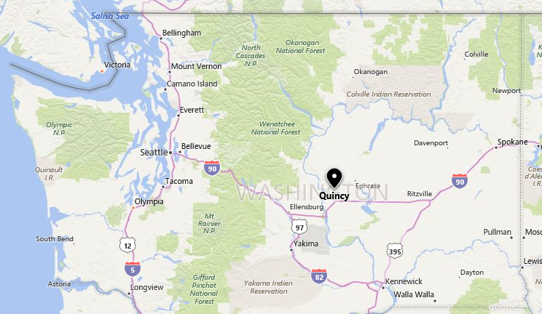




Project Background
The City of Quincy is located near the center of Washington State, about 150 miles from Seattle.
Technology firms have located data centers in Quincy requiring expansion of its infrastructure and development of the Quincy Water Reuse Project (QWRP).
Phase 1 of the project will need to be completed by the end of 2019 to meet the industrial client requirements.
VANTAGE

Slide 5

Project Background
The U.S. Bureau of Reclamation (Reclamation) has required that Quincy’s industrial wastewater treatment plant (IWTP) cease discharge to an irrigation wasteway.
All work to create a new replacement outfall must be completed by 2022 in accordance with an agreement with Reclamation.
Rapid influx of data centers requiring specifically treated water.
The main component of the QWRP is the industrial reuse water treatment plant (IRWTP).
Currently, portions of Stage 1 components are in place and operating. This project will construct the remaining components of Stage 1 and portions of Stage 2.
The QWRP and IRWTP Stage 1 are being built out in partnership with Microsoft.
Work will occur at the IRWTP in multiple locations along the utility corridor.

Slide 6
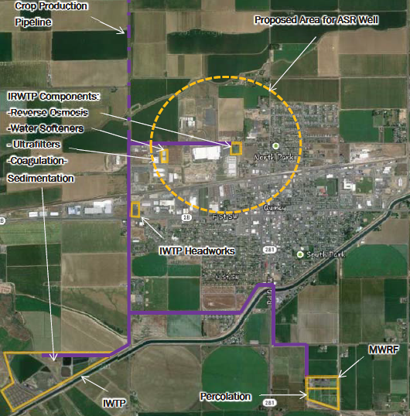
System Layout
Four sites
Pipelines
Four Microsoft Sites

Slide 7
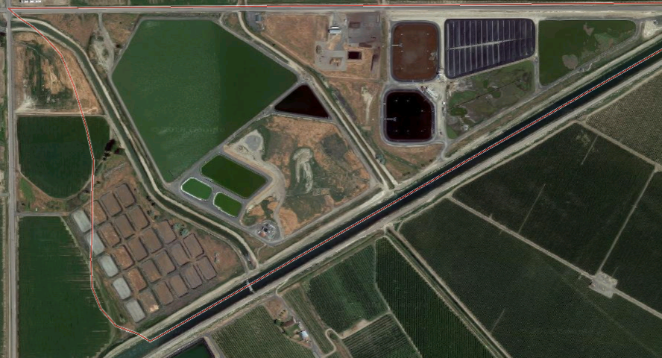
IWTP Site
Chemical Clarifiers
Primary Clarifiers
3 Quincy Projects
1 Microsoft Project
Brine Pond
Residuals Management

Slide 8
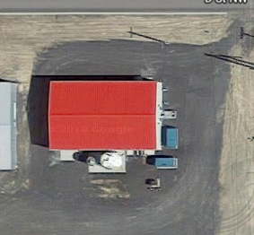
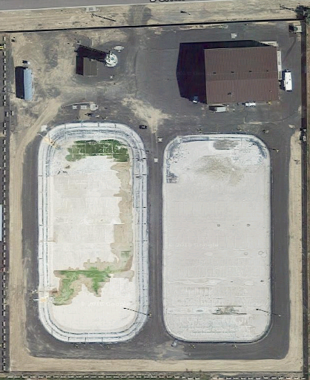
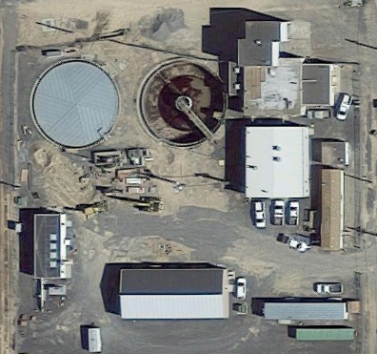
Filters, IX and RO
RO Tank
Upgrade RO System
Upgrade IX System
Three Sites
3 Quincy Projects
Two Microsoft Projects
Wet Well
Ultrafiltration
Wastewater Pump Stations

Slide 9
Team Organization
HDR will be Owner’s Representative on the Project
Design will be performed by;
  Gray and Osborne
  Brown and Caldwell
  HDR Engineering
Working jointly with Microsoft
  CH2M Hill/Jacobs
  Black & Veatch

Slide 10
Project Organization Chart

Slide 11
Team Organization
Program Manager – Emil Voges, PE
  Water and wastewater engineer
  Over 20 years experience working on Design-Bid-Build and Alternative Delivery projects
  Quincy Water Reuse Project developer for 10 years

Slide 12
Team Organization
Project/Construction Manager – Dan Becker CCM, PMP
  Over 35 years experience working for contractors and owners
  Worked with 3 agencies in WA State using GC/CM
  Worked with 5 agencies throughout the US using CMAR
  Member of the Engineers Joint Construction Document Committee (EJCDC) developing construction, Design-Build and CMAR documents
  Worked with 6 public and private owners using Design-Build

Slide 13
Project Budget
Costs for Professional Services (A/E, Legal etc.) | $ 2,000,000
Estimated project construction costs (including construction contingencies)* | $ 20,000,000
Contract administration costs (owner, cm etc.) | $ 750,000
Contingencies (design & owner) | $ 1,500,000
Sales Tax | $ 2,000,000
Total | $ 25,250,000
* Initial build $10 million, full build out $20 million

Slide 14
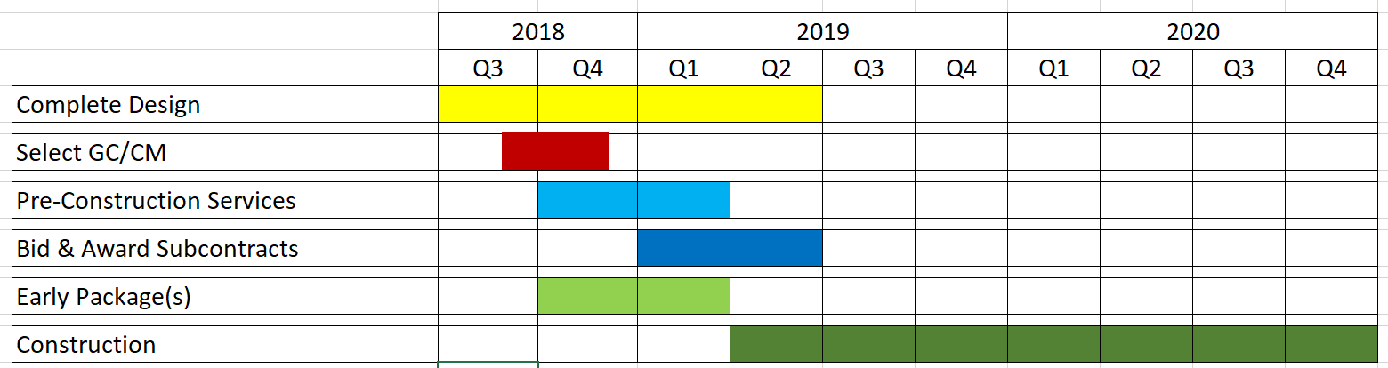
Project Schedule

Slide 15
Heavy Civil GC/CM Criteria
39.10.340
General contractor/construction manager procedure—Uses.
(1) Implementation of the project involves complex scheduling, phasing, or coordination;
(2) The project involves construction at an occupied facility which must continue to operate during construction;
(3) The involvement of the general contractor/construction manager during the design stage is critical to the success of the project;
(4) The project encompasses a complex or technical work environment;
(5) The project requires specialized work on a building that has historic significance; or
(6) The project is, and the public body elects to procure the project as, a heavy civil construction project.

Slide 16
Heavy Civil GC/CM Criteria
39.10.340
General contractor/construction manager procedure—Uses.
(1) Implementation of the project involves complex scheduling, phasing, or coordination;
(2) The project involves construction at an occupied facility which must continue to operate during construction;
(3) The involvement of the general contractor/construction manager during the design stage is critical to the success of the project;
(4) The project encompasses a complex or technical work environment;
(5) The project requires specialized work on a building that has historic significance; or
(6) The project is, and the public body elects to procure the project as, a heavy civil construction project.

Slide 17
Heavy Civil GC/CM Criteria
39.10.340
General contractor/construction manager procedure—Uses.
(1) Implementation of the project involves complex scheduling, phasing, or coordination;
(2) The project involves construction at an occupied facility which must continue to operate during construction;
(3) The involvement of the general contractor/construction manager during the design stage is critical to the success of the project;
(4) The project encompasses a complex or technical work environment;
(5) The project requires specialized work on a building that has historic significance; or
(6) The project is, and the public body elects to procure the project as, a heavy civil construction project.

Slide 18
Heavy Civil GC/CM Criteria
39.10.340
General contractor/construction manager procedure—Uses.
(1) Implementation of the project involves complex scheduling, phasing, or coordination;
(2) The project involves construction at an occupied facility which must continue to operate during construction;
(3) The involvement of the general contractor/construction manager during the design stage is critical to the success of the project;
(4) The project encompasses a complex or technical work environment;
(5) The project requires specialized work on a building that has historic significance; or
(6) The project is, and the public body elects to procure the project as, a heavy civil construction project.

Slide 19
Heavy Civil GC/CM Criteria
39.10.340
General contractor/construction manager procedure—Uses.
(1) Implementation of the project involves complex scheduling, phasing, or coordination;
(2) The project involves construction at an occupied facility which must continue to operate during construction;
(3) The involvement of the general contractor/construction manager during the design stage is critical to the success of the project;
(4) The project encompasses a complex or technical work environment;
(5) The project requires specialized work on a building that has historic significance; or
(6) The project is, and the public body elects to procure the project as, a heavy civil construction project.

Slide 20
Heavy Civil GC/CM Criteria
39.10.340
General contractor/construction manager procedure—Uses.
(1) Implementation of the project involves complex scheduling, phasing, or coordination;
(2) The project involves construction at an occupied facility which must continue to operate during construction;
(3) The involvement of the general contractor/construction manager during the design stage is critical to the success of the project;
(4) The project encompasses a complex or technical work environment;
(5) The project requires specialized work on a building that has historic significance; or
(6) The project is, and the public body elects to procure the project as, a heavy civil construction project.

Slide 21
Heavy Civil GC/CM
We selected Heavy Civil GC/CM because:
  The work on the QWRP is primarily installation of pipelines and pumping facilities.
  The majority of this type work is usually performed by the contractor vs. subcontractors

Slide 22
Response to PRC Questions
            Is the project going to have a Project Labor Agreement (PLA)? If so, are they planning to have a dual benefit reimbursement program?
    The Project will not have a PLA.
            2. Will there be any W/MBE or DBE goals on these projects?
The City will have goals for the project. The City is in the process of determining what those goals will be.

Slide 23
Questions

