Slide 1


DISCOVERY ELEMENTARY ADDITION
Capital Projects Advisory Review Board
Project Review Committee
Request for GC/CM Project Delivery Method
January 23, 2019

Slide 2
AGENDA
Project Team
Project Background
  Traditional delivery method not desirable
Meets Qualifying GC/CM Criteria
  Qualifying Project
  Management Plan
    Project Team
    Schedule
    Budget
    Funding
Project Summary
Questions

Slide 3
PROJECT TEAM
MUKILTEO SCHOOL DISTRICT
Karen Mooseker, Executive Director of District Support Services
  7 years experience with K-12 construction projects
  GC/CM experience – 4 projects
  Member of Capital Projects Advisory Review Board (CPARB)
Shelly Henderson, Manager of Capital Projects
  25 years experience with K-12 construction projects
  GC/CM experience – 8 projects
Amy Stenvall, Fiscal Analyst
  10 years experience with K-12 construction projects
  GC/CM experience – 6 projects
OAC SERVICES – GC/CM ADVISOR
Steve Murakami, Vice President
  23 years experience with K-12 construction projects
  Extensive GC/CM experience leading and assisting Tacoma Public School and Lake Washington School District
Dan Chandler, Principal
  40 years of construction experience
  GC/CM experience - 46 GC/CM projects and 20 DB projects

Slide 4
PROJECT TEAM
PACIFICA LAW GROUP – LEGAL COUNSEL
Christopher Hirst, Senior Counsel
  Extensive GC/CM Experience
Zak Tomlinson, Partner
  Extensive GC/CM Experience
HUTTEBALL + OREMUS ARCHITECTURE
Kevin Oremus, Principal-in-Charge
  33 years of experience with K-12 construction projects
  GC/CM experience – Anacortes HS, Inglemoor HS Concert Hall + Music Building
Katie Pond, Principal
  12 years of experience with K-12 construction projects
  GC/CM experience – Anacortes HS, Inglemoor HS Concert Hall + Music Building
Ingrida Sanders, Design Architect
  17 years of experience with K-12 construction projects
  GC/CM experience – Anacortes HS
Marissa Rutler, Job Captain/Project Support
  5 years of experience with K-12 construction projects
  GC/CM experience – Inglemoor HS Concert Hall + Music Building

Slide 5
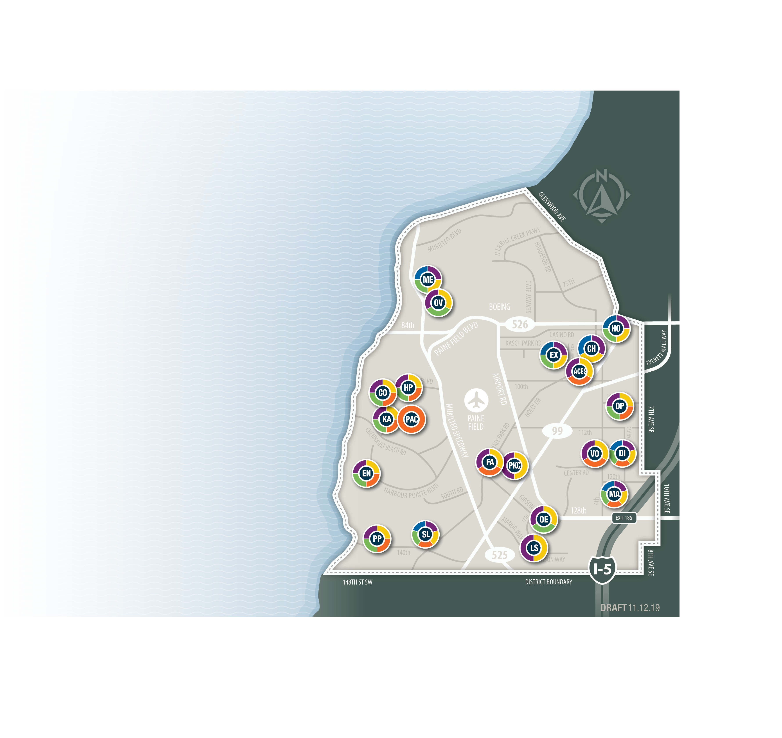
PROJECT BACKGROUND
DISTRICT NEED:
  Aging facilities district-wide.
  Enrollment growth; 600 K-5 seats short
  by 2026. No vacant land available.
DISCOVERY ES SITE:
  Shared site between elementary and
  middle school.
  Current elementary enrollment: 689
  50% of current capacity in portables.
  Original 1988 structure plus
  14 portable classrooms.
PROPOSED ADDITION:
  25,000 sf addition
  16-20 classrooms with
  support spaces.

Slide 6
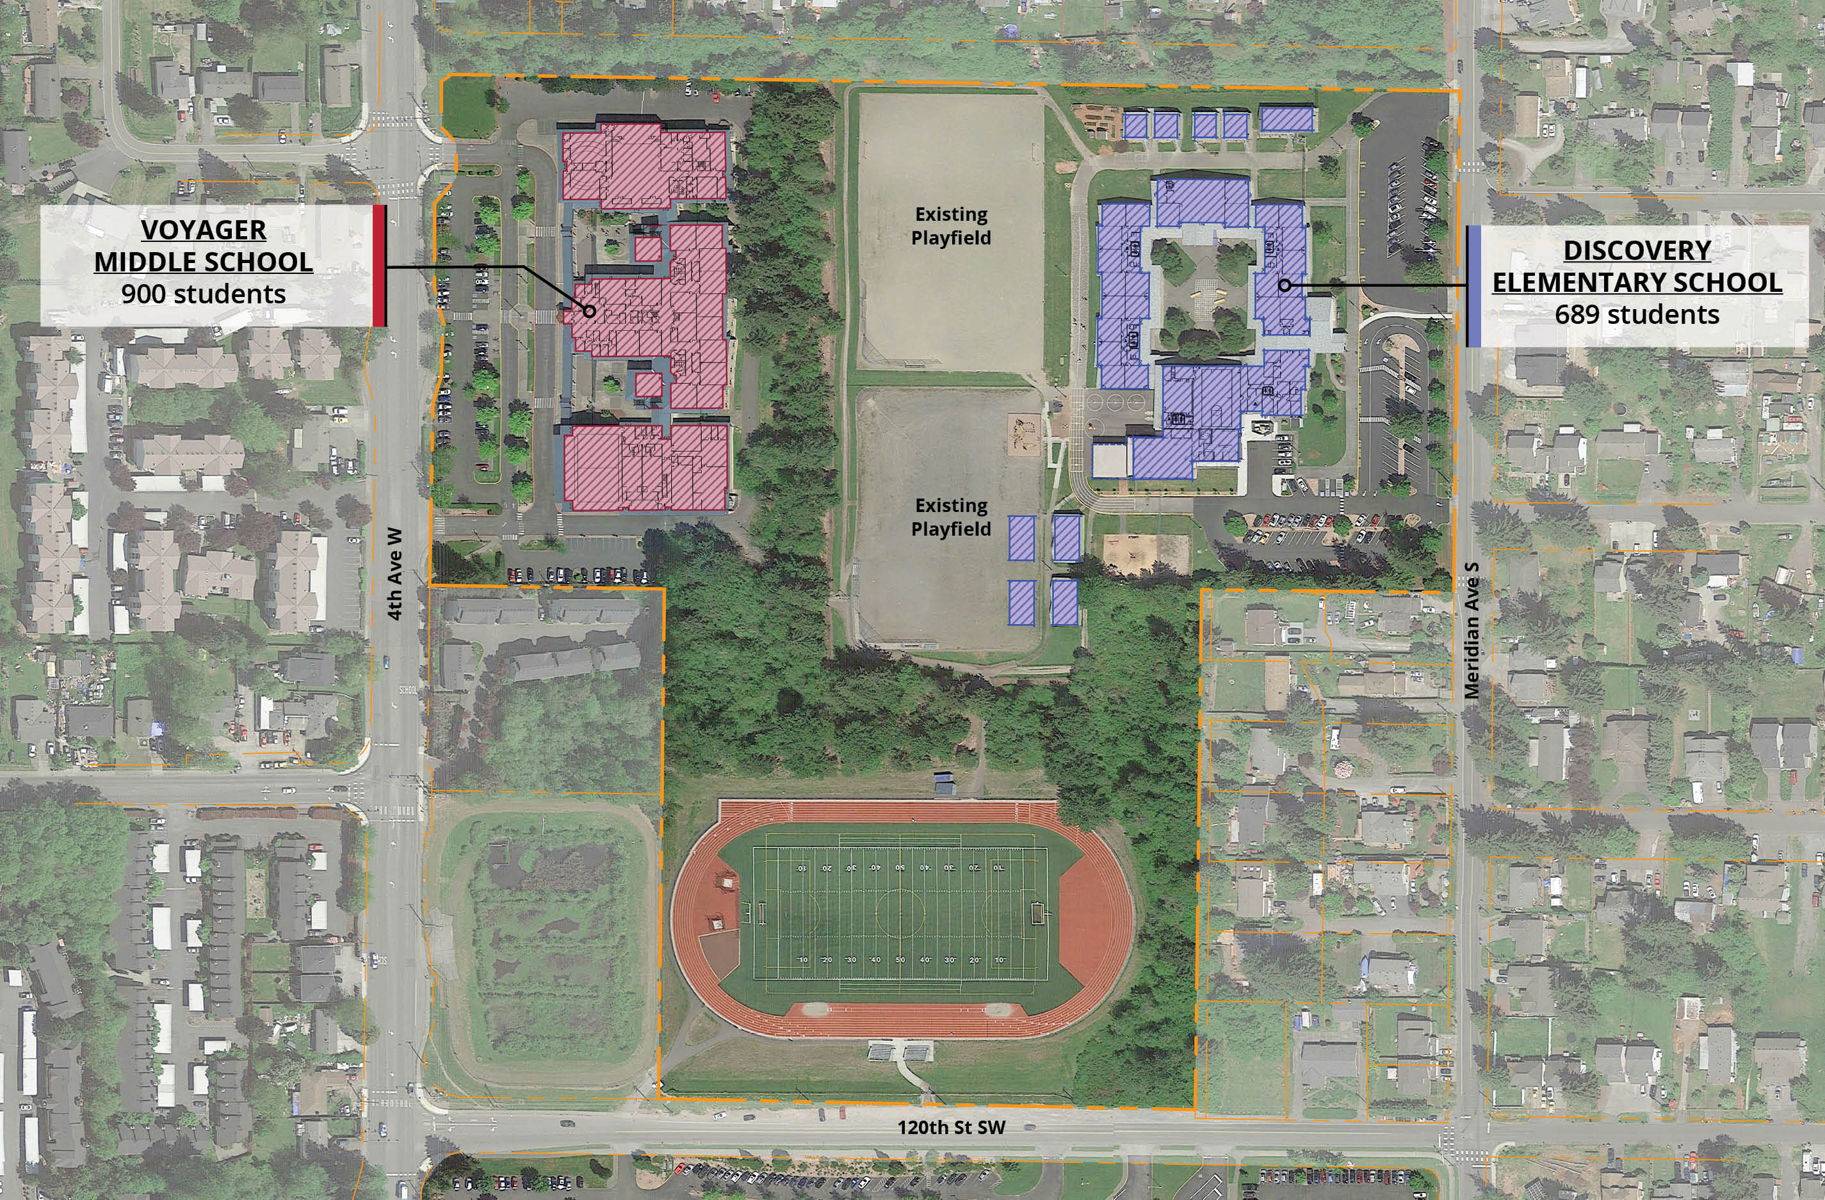
EXISTING SITE
PROJECT BACKGROUND

Slide 7
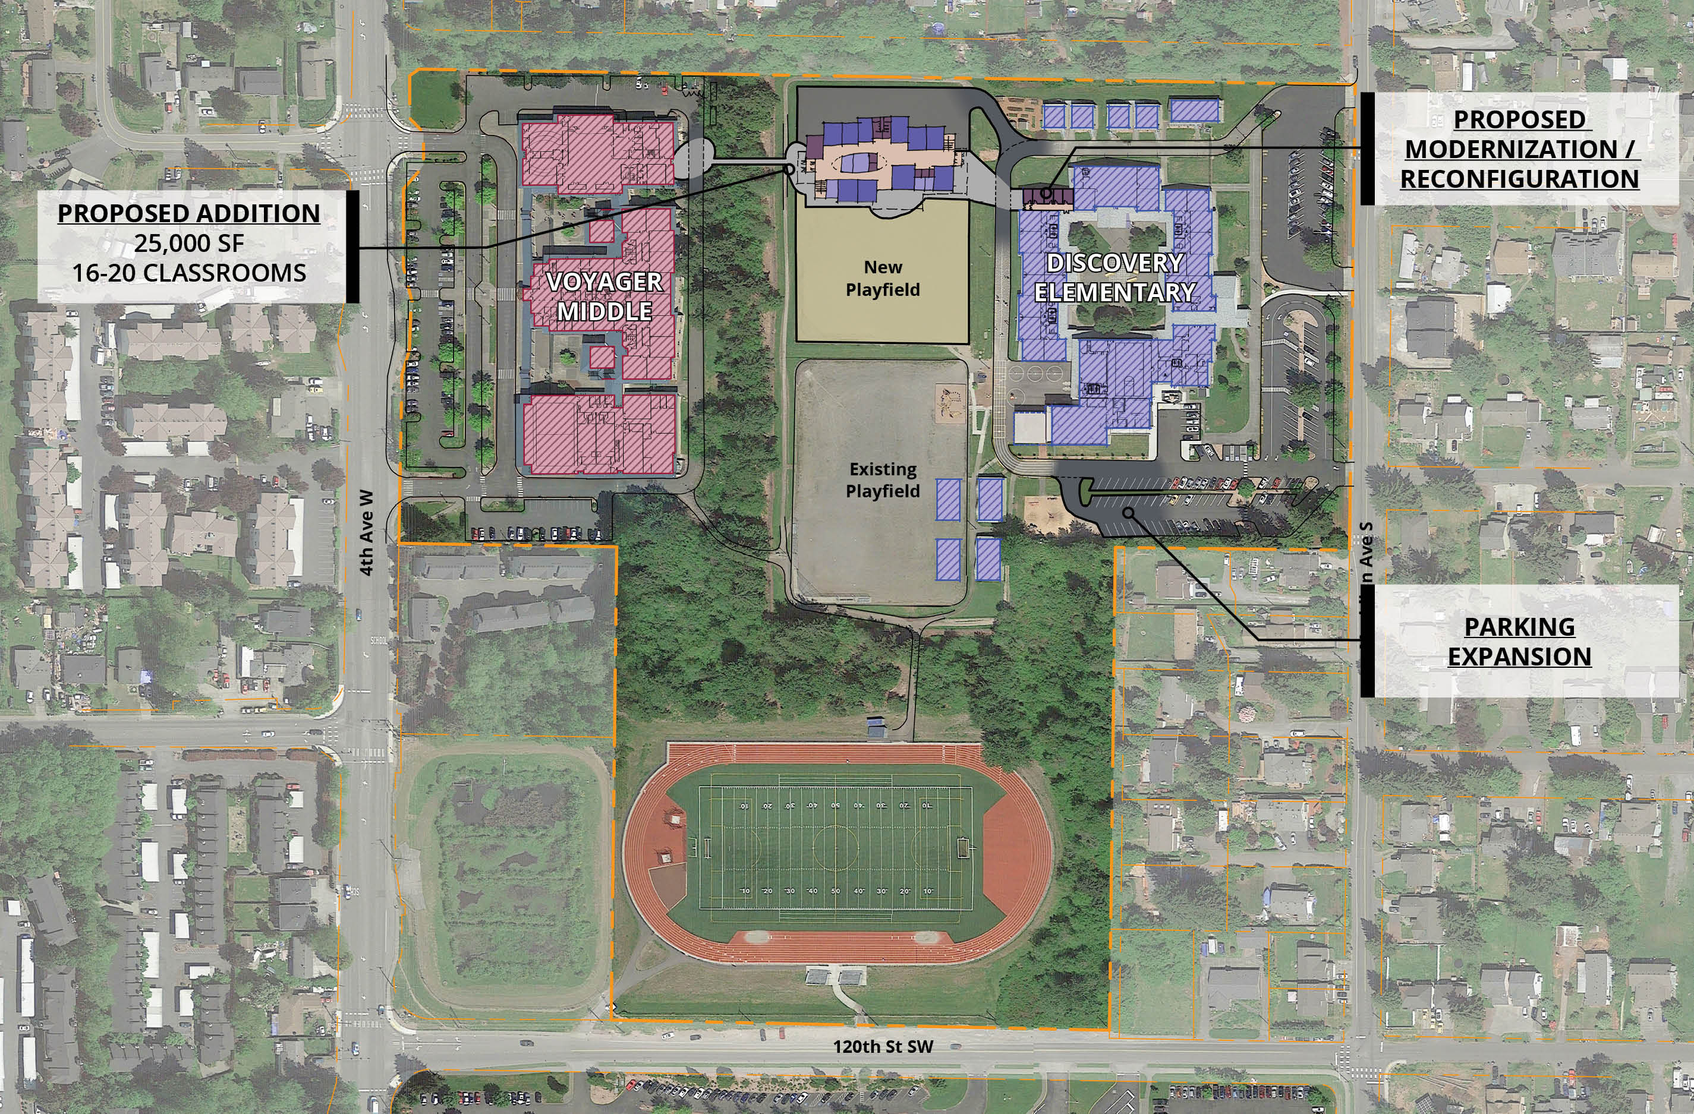
PROPOSED ADDITION
PROJECT BACKGROUND

Slide 8

QUALIFYING GC/CM PROJECT
(RCW 39.10.340)
This project meets 3 of the 5 criteria.
Implementation of the project involves complex scheduling, phasing or coordination.
The project involves construction at an existing facility that must continue to operate during construction
Involvement of the GC/CM during the design stage is critical to the success of the project
The project encompasses a complex or technical work environment.
The project requires specialized work on a building that has historical significance.

Slide 9
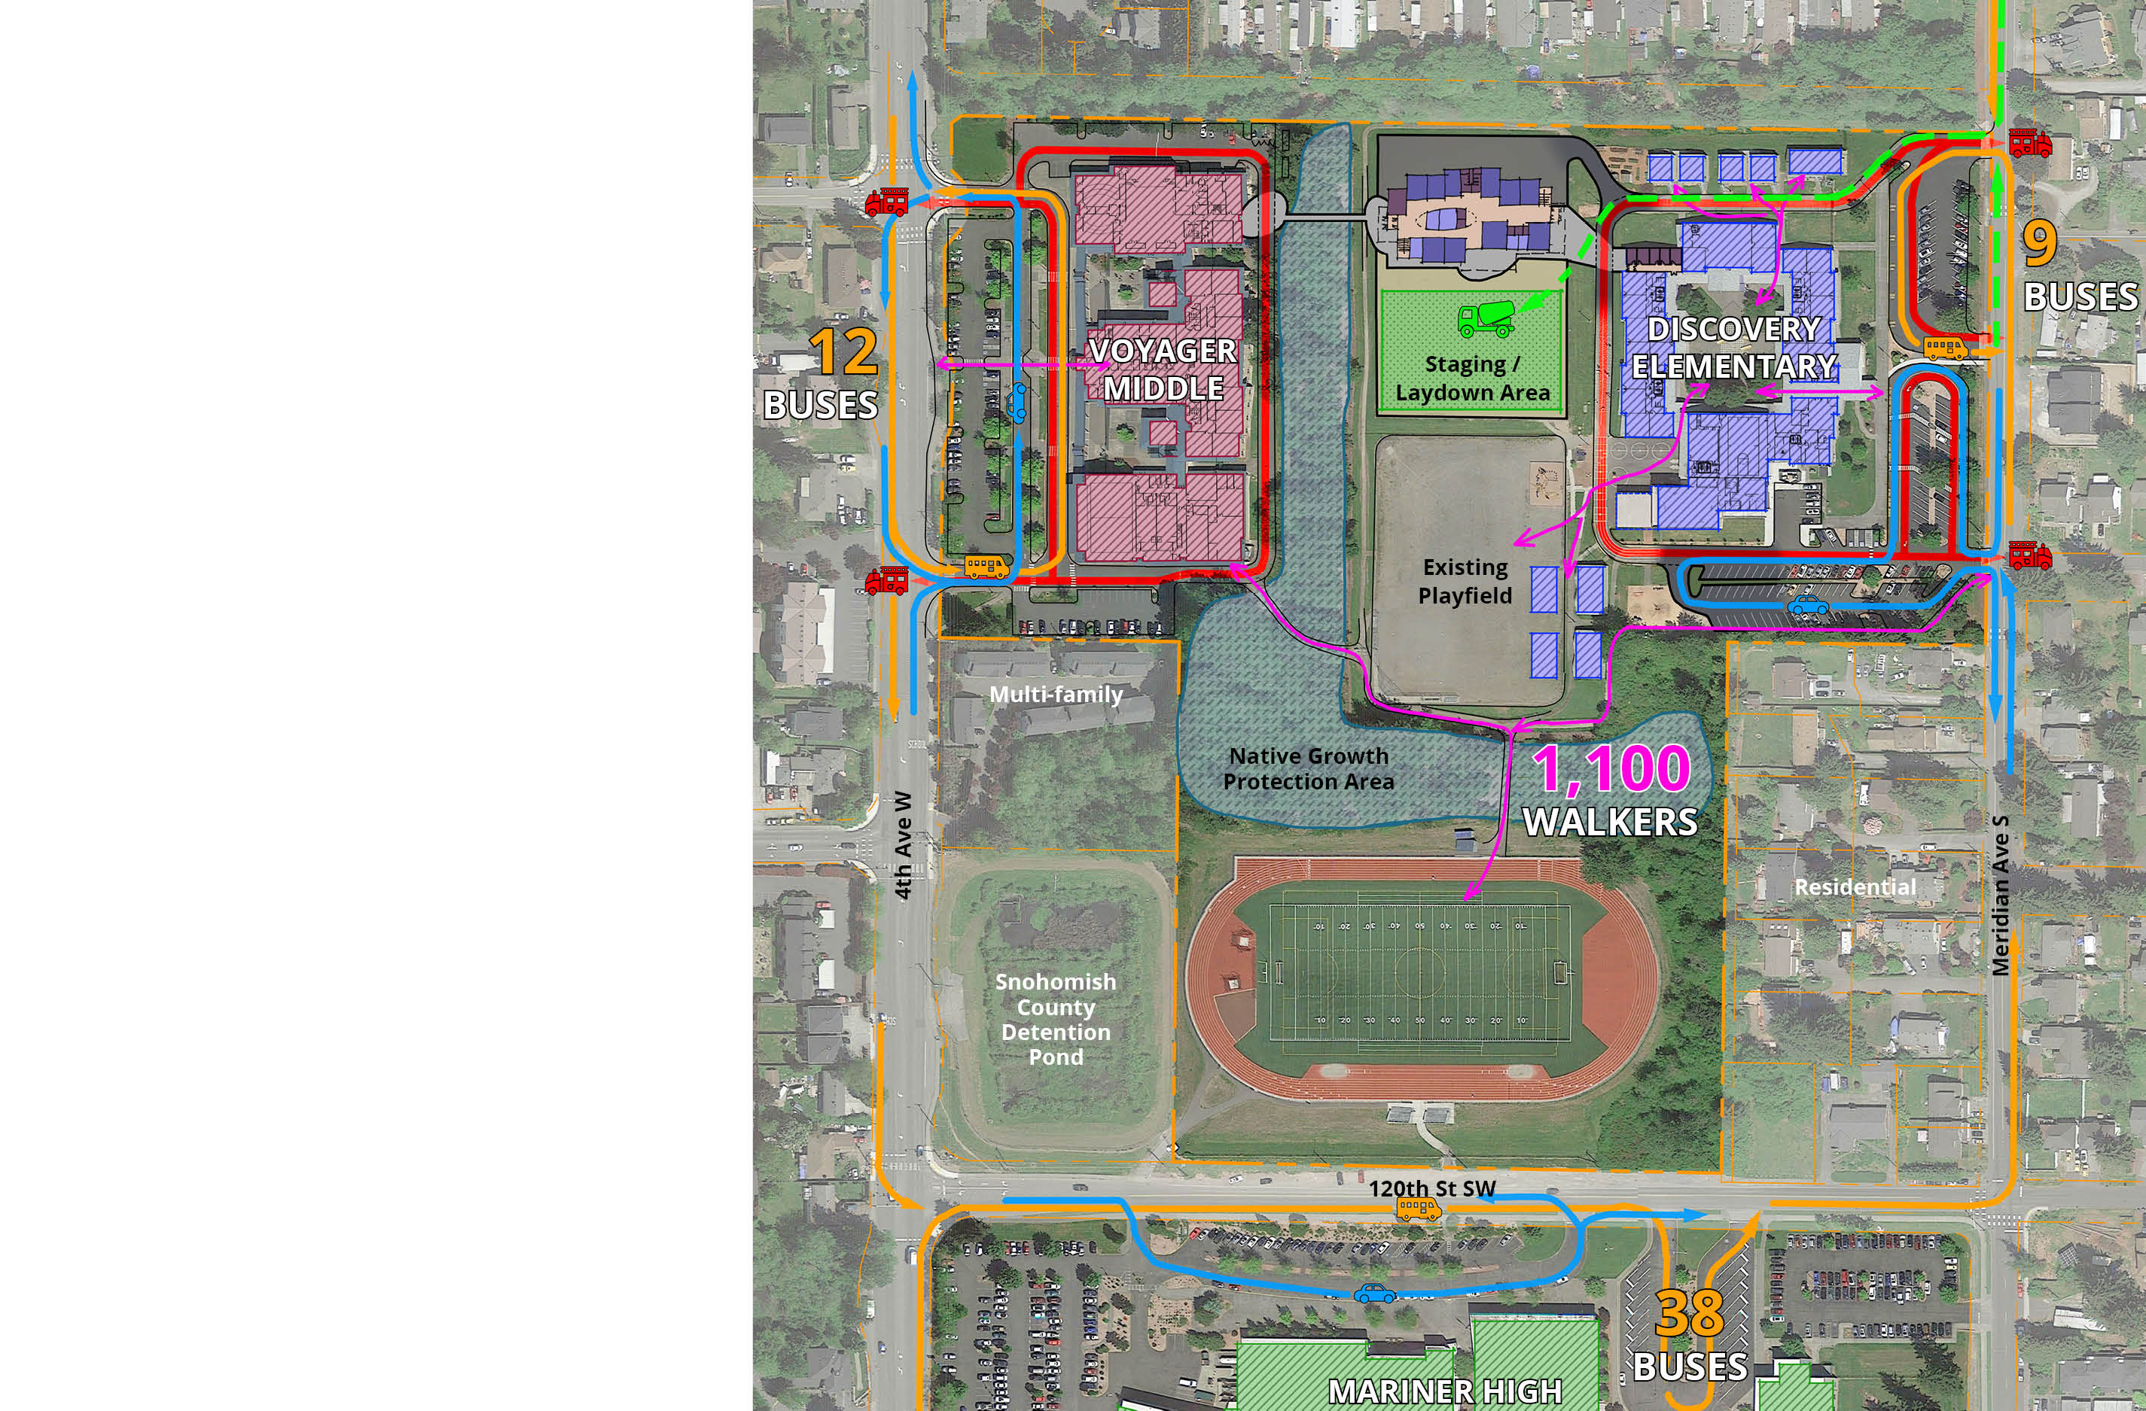
1. COMPLEX SCHEDULING, PHASING & COORDINATION
QUALIFYING GC/CM PROJECT
  Increasing enrollment dictates that building must open Fall 2022.
  Phasing of work at Discovery Elementary and Voyager Middle School to connect new structure to existing buildings.
  Routing & connection of utilities to aging infrastructure.
  Confined building site with minimal construction access, laydown area & staging area.
  Sensitive areas directly adjacent to construction site.

Slide 10
QUALIFYING GC/CM PROJECT
2. OCCUPIED SITE
  All three schools will be fully operational during construction.
  Safety hazards:
    Students traveling through and around centralized construction zone.
    Demolition of existing classrooms at Discovery Elementary in order to complete new connection.
    Construction adjacent to active play areas.
    Maintain fire access loop during construction phases and allow student access to fields.
    Maintain student access to all buildings during all phases of construction.

Slide 11
QUALIFYING GC/CM PROJECT
3. GC/CM INVOLVEMENT IS CRITICAL TO THE SUCCESS OF THE PROJECT
  GC/CM brought on during Schematic Design
    Prioritize options from conceptual design to ensure a truly integrated design process.
    Understand market for labor and materials to determine early procurement and early site work.
    Mitigate impact of adding a new building to aging site.
  GC/CM assistance with initial site investigation a significant benefit.
  GC/CM input on access, phasing, and safety plans tailored around site restraints.

Slide 12
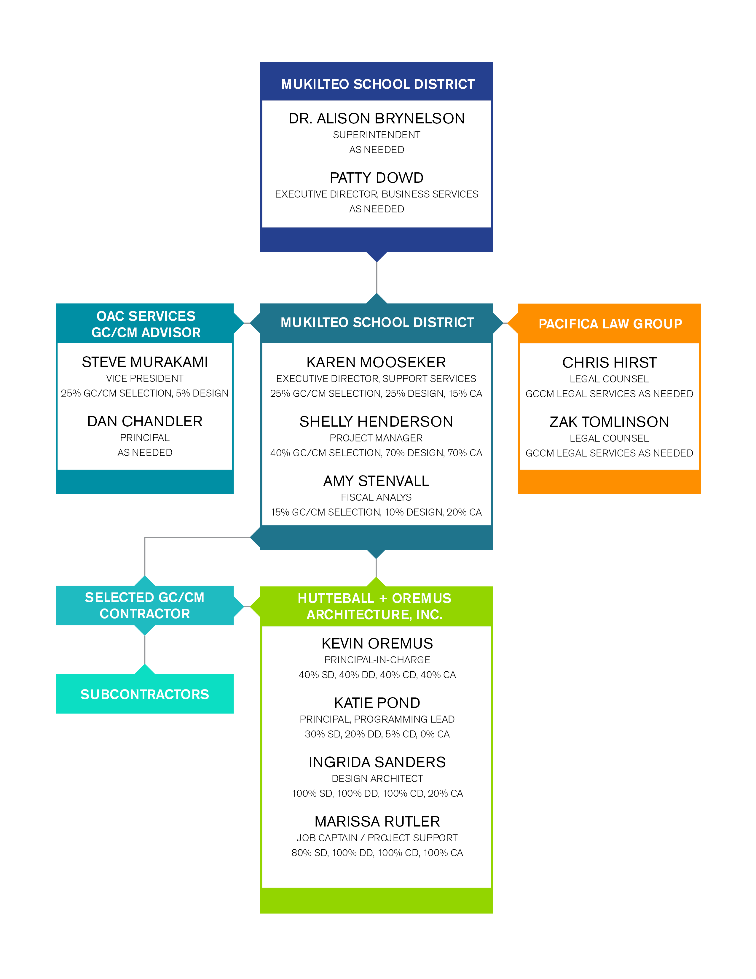
MANAGEMENT PLAN
Project Team
  Experience
    All members of the project team have GC/CM experience.
  Controls
    Minimum monthly,
    high-level team
    meeting with
    principal-level
    involvement.
    Regular school board
    updates & approvals.
  Procurement
    OAC & Pacific Law
    Group guidance.
    Formal selection with 3-step
    RFP process, and General Conditions & Agreement.

Slide 13
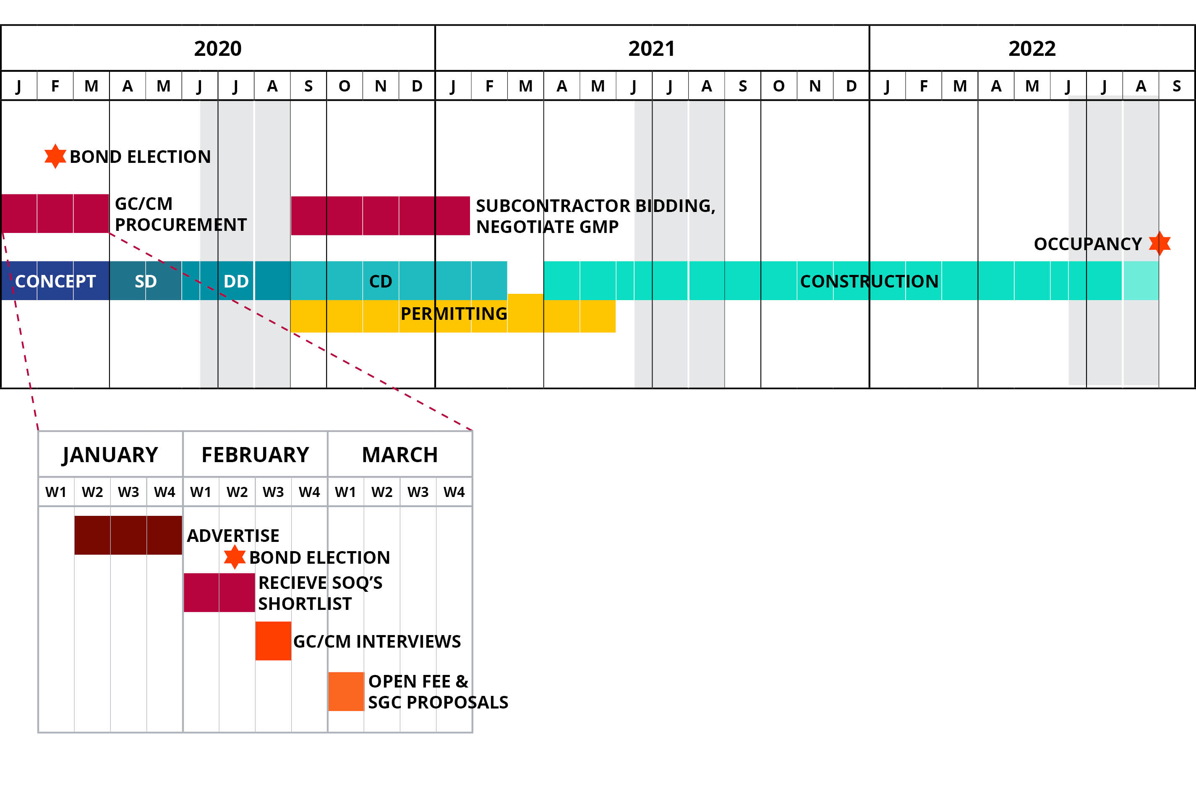
MANAGEMENT PLAN
PROJECT SCHEDULE

Slide 14
MANAGEMENT PLAN
Project Budget
Costs for Professional Services | $2,535,000
Estimated Project Construction Costs (MACC including 3% GC/CM Contingency, SGC’s, Pre-Con & NSS Allowance) | $19,500,000
Equipment and Furnishing Costs | $1,365,000
Contract Administration Costs | $1,170,000
Owner Contingency (3% Design, 7% Construction) | $1,195,000
Other Related Project Costs (Utility Fees, permits, bid advertising, moving, etc.) | $1,530,000
Sales Tax | $1,950,000
TOTAL: | $30,000,000
Funding
  Funding will be secured through the passage of the $240 million capital improvement bond set to be placed on the ballot of voter consideration in the upcoming February 2020 election.
  When the bond passes, it will generate $30 million in local funds for this project.

Slide 15
PROJECT SUMMARY
Traditional delivery method is not desirable
Meets three qualifying criteria
GC/CM will be under contract early in Schematic Design phase
Public body is qualified
Public benefits

Slide 16
QUESTIONS?

