Slide 1
Fawcett Elementary School Replacement Project
RCW 39.10 Alternative Public Works Contracting Progressive Design/Build
December 3, 2020

Slide 2
Agenda
Introductions
Tacoma Public Schools
Business Equity
Capital Project History
The Project
Project Budget
Project Schedule
Why Design Build
Public Body Qualifications
Summary

Slide 3
Presenting Team
Tacoma Public Schools
Morris Aldridge – Executive Director of Planning and Construction
Parametrix
Jim Dugan – Alternative Project Delivery Program Advisor
Dan Cody – Design Build Procurement and Advisory
Greg Stidham – Project Manager/Construction Manager
Maggie Anderson – Project Documentation Controls

Slide 4
Additional Team Members
Tacoma Public Schools
Chris Williams – Chief Operating Officer
Perkins Coie
Graehm Wallace – External D/B Legal Counsel

Slide 5
Tacoma Public Schools
Founded in 1869
Comprised of:
36 Elementary Schools
11 Middle Schools
10 High Schools
Numerous Special Programs
4th largest school district in the State of Washington
Approximately 30,000 students
Over 5,000 employees
Serving Pre-K thru 12th grade
One of the largest employers in Tacoma

Slide 6
Business Equity: TPS Community Inclusion Plan
Tacoma Public Schools is committed to Community Inclusion, as partnerships are critical to student education and community health and sustainability.
In 2018, Tacoma Public Schools committed to:
Maintain and increase contracts with local businesses by:
Increasing local share of total construction from 15% to 30%
Adopt Governor’s diverse business goals, including:
10% Minority-Owned Business Enterprises,
6% Woman-Owner Business Enterprises, and
5% Small Business Enterprises (SBE)

Slide 7
Business Equity: TPS Community Inclusion Results
The Tacoma Public Schools actual performance against goals beginning in 2017 and summarized as of YTD 2020 is as follows:
MBE Goal: 10% Actual: 25.3% Actual/Goal: 253%
WBE Goal: 6% Actual: 8.2% Actual/Goal: 137%
SBE Goal: 5% Actual: 12.2% Actual/Goal: 244%
Local Share Goal: 30% Actual: 64% Actual/Goal: 213%
Apprenticeships
All major construction projects are exceeding apprenticeship utilization requirements

Slide 8
Capital Project History

Slide 9
TPS Project Delivery Experience & Qualifications
Since 2001, TPS has successfully delivered 36 large capital projects valued at nearly $1.2 billion.
Augmenting and Enhancing the internal team – Since 1998 teaming with external consulting teams.
TPS has developed internal processes and control systems to efficiently plan and execute the work.
Between 2001-2020 TPS has utilized D/B/B (24), GC/CM (8), & D/B (4) methods of project delivery.
Notes:
Controls
-Weekly Staff Meetings
-Weekly progress meetings
-One on one PM daily and weekly meetings
-Standing daily and weekly meetings with COO
-Multi Vista- Photographic Interactive As-Built
-Digitized As Builts and OEM Manuals in the Cloud (Skisite)
-Chalk Schools- Soup to nuts process for Project approvals

Slide 10
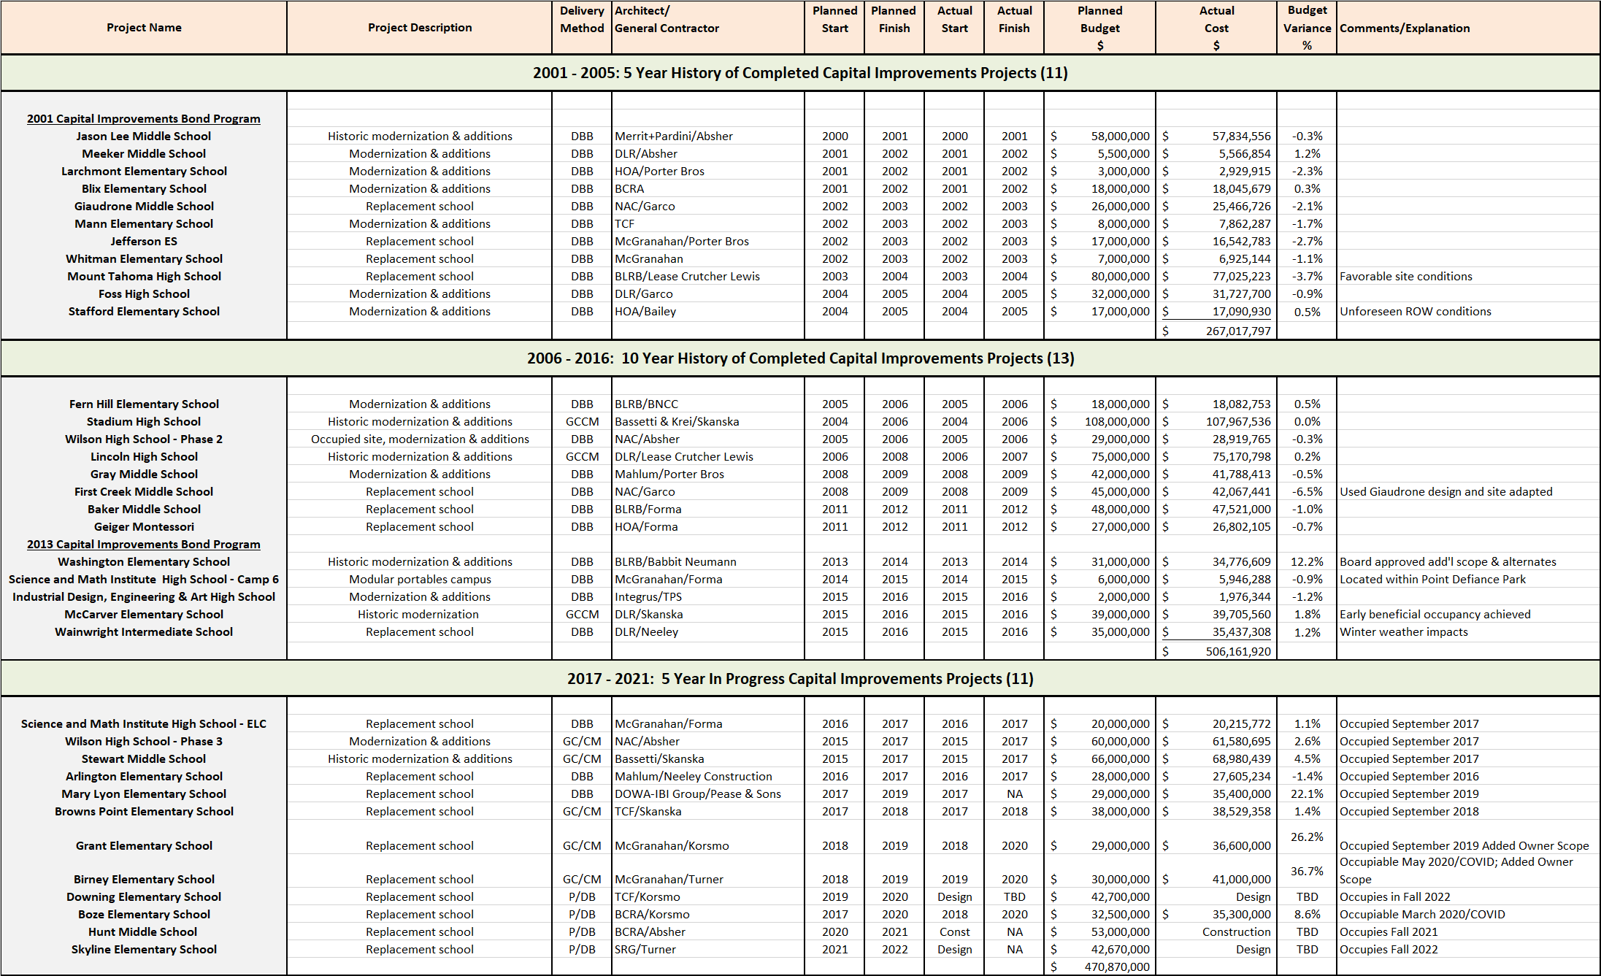
TPS Public Body Experience: 2001 - 2020
Notes:
As a public body depth of public works experience
TPS is a major capital project builder

Slide 11
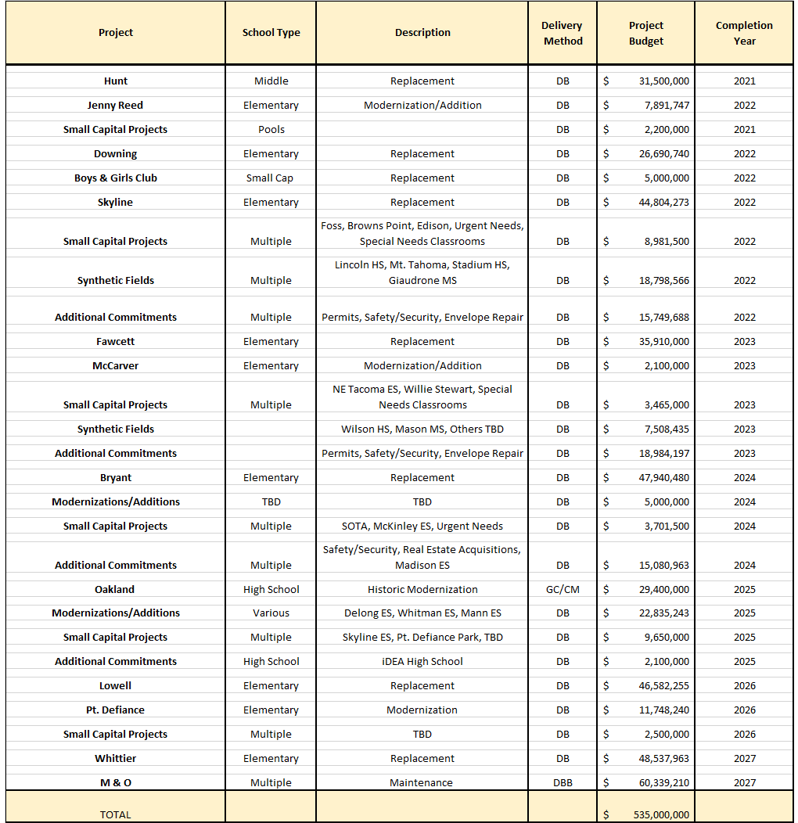
TPS 2020 Capital Bond Program - $535M (Approved FEB 2020)
Notes:
Yellow Highlighted GCCM Projects
Green Highlighted- Just beginning or starting in the next couple of years
May or may not be occupied

Slide 12
The Project

Slide 13
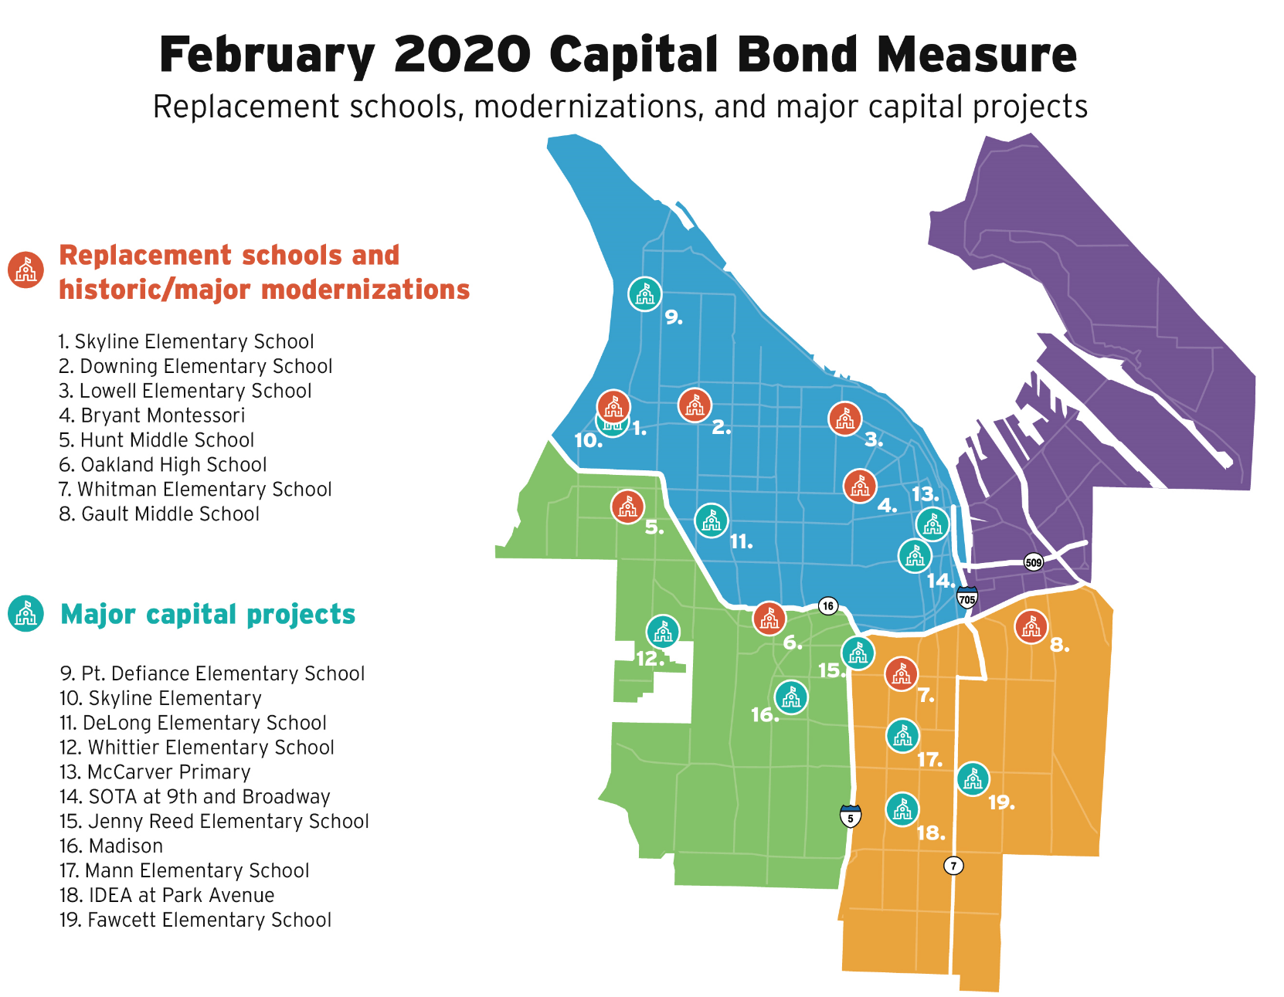
Project Location
Fawcett Elementary School

Slide 14
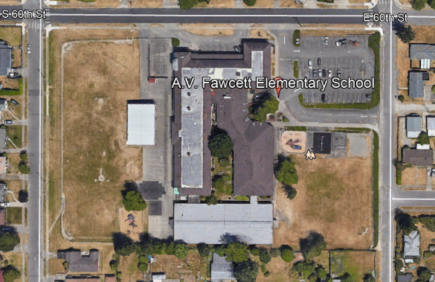
Current Site Overview

Slide 15
Project Description
Located in Southeast Tacoma
5.6-acre site
Replace the existing facility
Build to house 500 students
50,000 sq. ft.; Multi-story
Demolish existing facility – Build new school, Students swing to McKinley Elementary School
Board approved budget: 35.9$M (construction & soft costs)
Construction timeline: April 2022-June 2023
Occupancy - Fall of 2023

Slide 16
Project Budget
Category | Budget
Costs for professional services (A/E provided by D/B) (@12%) | $2,880,000
Estimated project construction cost (including 3% D/B contingency) | $24,000,000
Equipment & furnishing costs (includes technology) (@7.5%) | $1,800,000
Off-site costs | $600,000
Contract administration costs (Owner, CM etc.) (@3%) | $800,000
Contingences (Owner Project Contingency @ 5% of MACC) | $1,200,000
Other soft costs (Owner’s consultants, permits/fees, etc.) | $1,915,120
Sales Tax (@ 10.1% of A/E + Construction Cost) | $2,714,880
TOTAL: | $35,910,000

Slide 17
Project Schedule
PRC Application | October 20, 2020
PRC Presentation | December 3, 2020
Request for Qualifications Advertised | December 7 & 14, 2020
Pre-Submittal Meeting | December 16, 2020
Statement of Qualifications Due | January 11, 2021
Score SOQs/Shortlist Finalists | January 12 – January 14, 2021
Notify Submitters/Release RFP | January 15, 2021
Proprietary Meetings w/Finalists | January 25, 2021
Proposals Due – Cost Factors and Approach | February 5, 2021
Interviews | February 12, 2021
Score/Identify Most Qualified D/B | February 15 – February 18, 2021
Notify Submitters | February 22, 2021

Slide 18
Project Schedule
Contract Negotiations (3 weeks) | February 26 – March 19, 2021
NTP/Board Approval of D/B Contract | March 2021
Phase 1 & Preliminary Design Service (60%) | April 2021– November 2021
Negotiate GMP (1 month) | December 2021
Phase 2: Final Design & Permit (6 months) | January 2022 – June 2022
Site Permitting (4months) | December 2021 – March 2022
Building Permitting (4 months) | February 2022 – May 2022
Construction (13 months) | April 2022 – June 2023
Occupancy/Move In | July 2023 – August 2023
First Day of School | September 2023

Slide 19
Project Schedule
Procurement schedule allows for team formation, questions, addenda as needed prior to SOQ’s due
Assumes qualifications-based selection – design concepts discouraged - with cost factors playing a major role in selection.
Interviews will discourage design concepts by teams and focus on qualifications and approach.
Assumes cost-reimbursable contract – negotiated GMP
Possible early release of key bid packages and long lead items

Slide 20
Why D/B Delivery Method

Slide 21
Market Conditions
In Washington State, Between 2014 and 2020, Voters Were Asked to Approve $31.3B in Public K-12 Capital Bond Funding
Approximately $13.8B Were Approved – 44.2%
Public K-12 Capital Bond Measures Were Presented to the Voters in February, April and November Annually
In February 2020, WA State Voters Were Asked to Approve $9.4B in Public K-12 Capital Bond Funding
Approximately $1.8B Were Approved – 18.8%

Slide 22
Market Conditions
No Public K-12 Capital Bond Measures Went to the Voters in April and November of 2020
100% of the .4B Asked of the Voters in August 2020 Failed
Tacoma Public Schools $535 M Was Approved in February 2020
Assuming the Market Slows 2019-2023 and Climbs 2024-2028 – Following Historical 10 Year Cycles for Each
Funded Owners Market
Time for Innovation

Slide 23
Cost Certainty
Need to “Lock Down” the Project Cost Earlier
Project Budget and Program Drive Design
In D/B, the Contractor Holds the Design Contracts and Warrants the Design
Limited Risk of Change Orders – Only Change in Scope or Unforeseen Conditions
Design/Build is the Owners Best Strategy to Minimize Risk and Expedite Cost Certainty

Slide 24
Statutory Compliance
(5.1) If the construction activities are highly specialized and a D/B approach is critical in developing the construction methodology
(5.2) If the project provides opportunity for greater innovation and efficiencies between the designer and builder
(5.3) If significant savings in project delivery time would be realized

Slide 25
Public Benefit
Cost Certainty
Risk Mitigation
Earlier Occupancy
Accountability

Slide 26
Public Body Qualifications

Slide 27
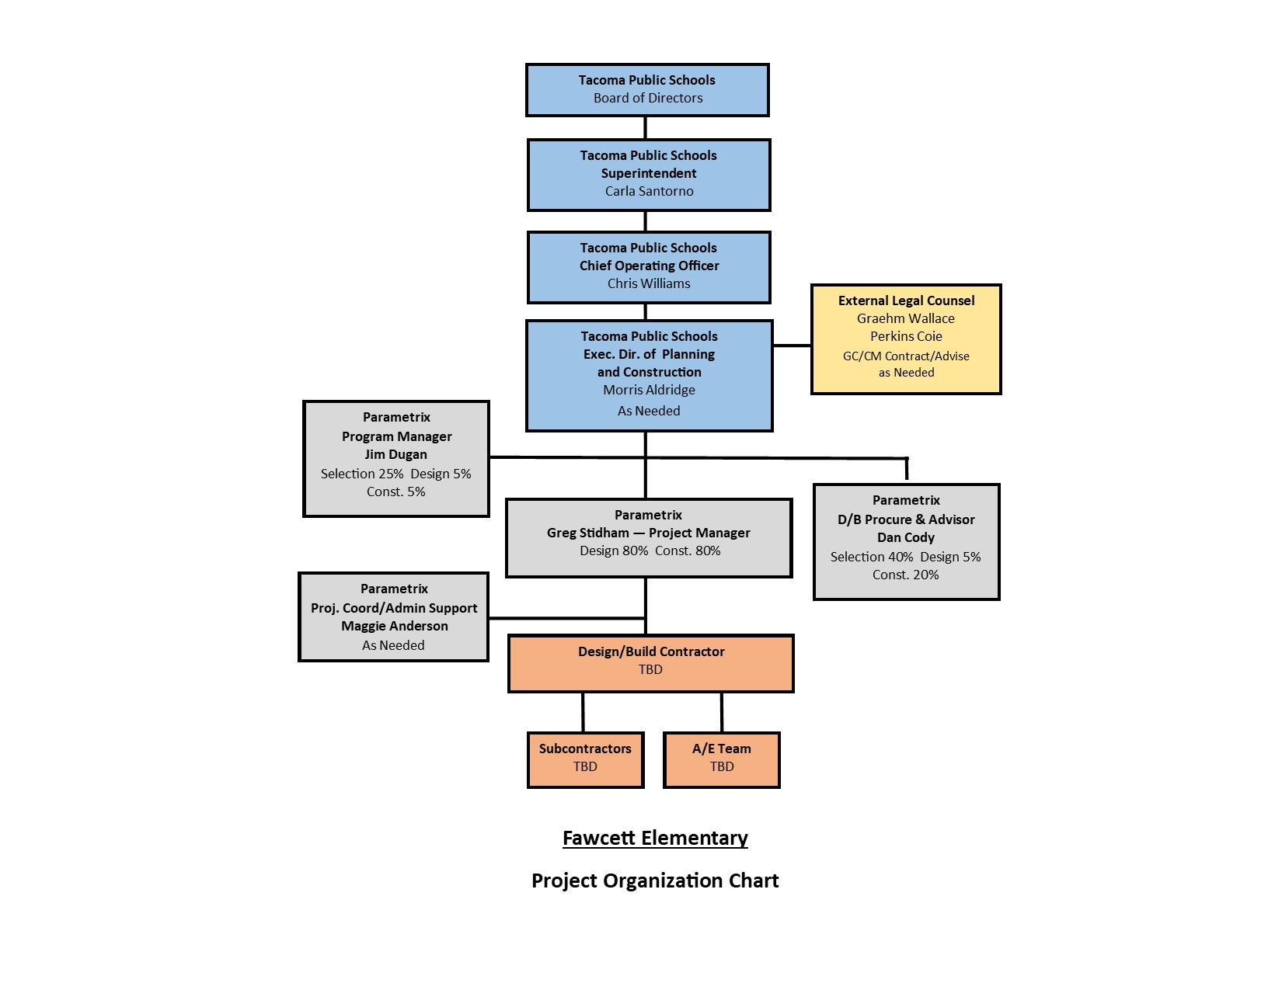
Project Organizational Chart

Slide 28
Leadership Team
Recent K-12 capital projects experience on projects of similar scope and complexity
All of which have been delivered using Design-Bid-Build, GC/CM & PDB
Track record of building projects on-time and within budget.
Track record of RCW 39.10 compliance
TPS completed Boze ES using PDB and is currently utilizing the PDB delivery method with Hunt MS now in construction. The D/B method has been effective on both projects.
Tacoma Public Schools
Morris Aldridge, Executive Director of Planning and Construction
34 Years of K-12 Experience
3 Years D/B Experience
4 Years CMAR/GC/CM Experience
TPS satisfies the public body qualifications by staff augmentation with consultants.

Slide 29
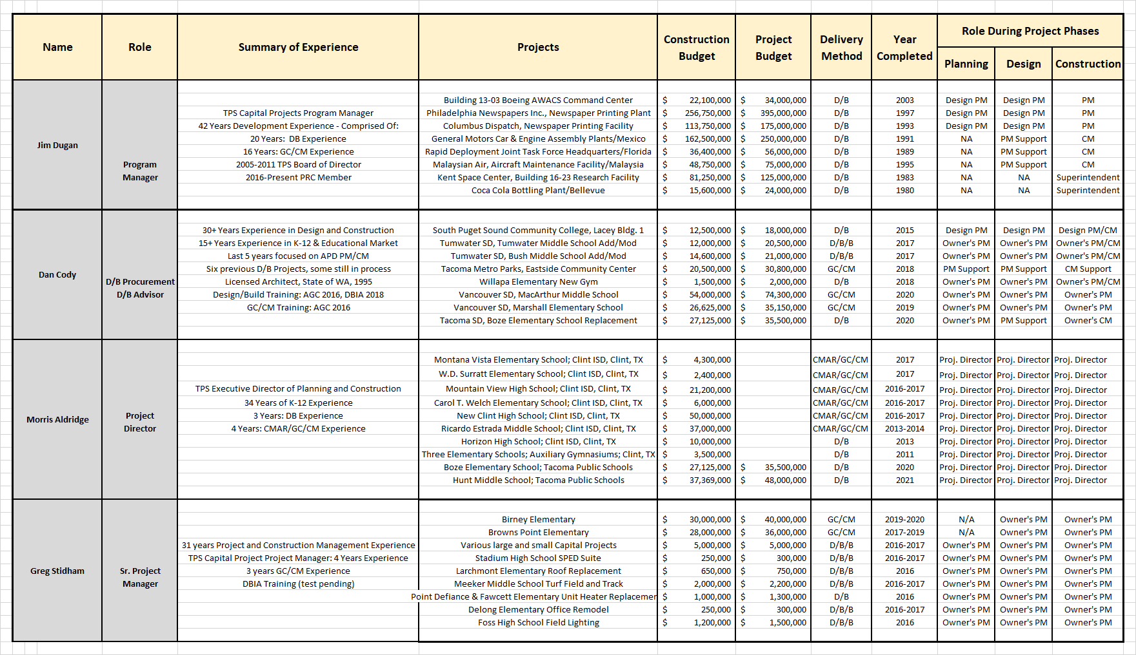
Design Build Experience

Slide 30
Summary
Project meets qualifying RCW criteria
Project Management Plan is developed and has clear, logical and proven lines of authority
Appropriate funding is in place for the project
Project Schedule allows for appropriate time to manage and complete the project
Project team has the required and necessary experience
Project team has the workload capacity
Appropriate construction budget has been identified for the project

Slide 31
Thank you

